Slide 1
FAKE NEWS DETECTION
USING SUPERVISED MACHINE LEARNING AND NATURAL LANGUAGE PROCESSING
Presented by –
Abhishek Bar(01)
Tanmay Sarkar(04)
Suvojit Mondal(06)
Shivam Saha(13)
Apurba Kuila(31)
Koustav Singha Roy(27)

Slide 2
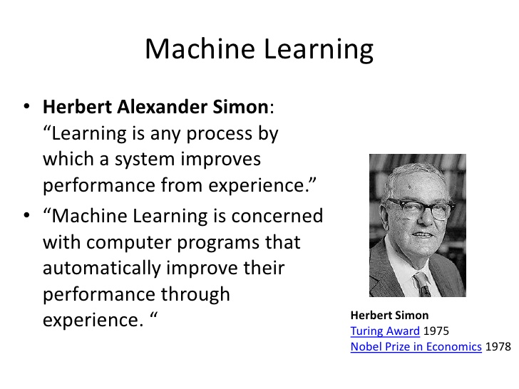

Slide 3
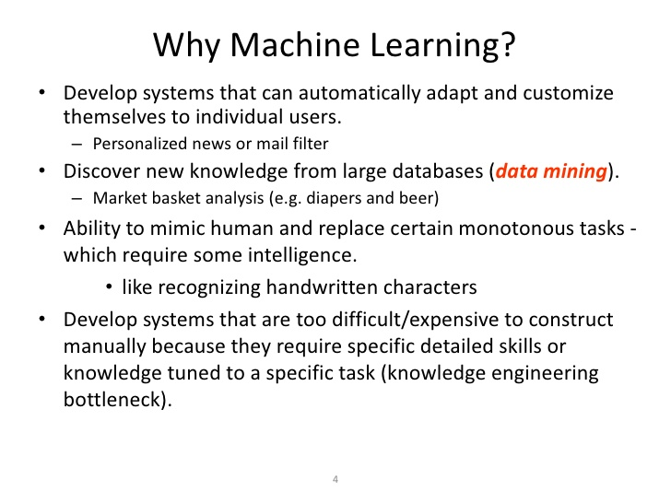

Slide 4
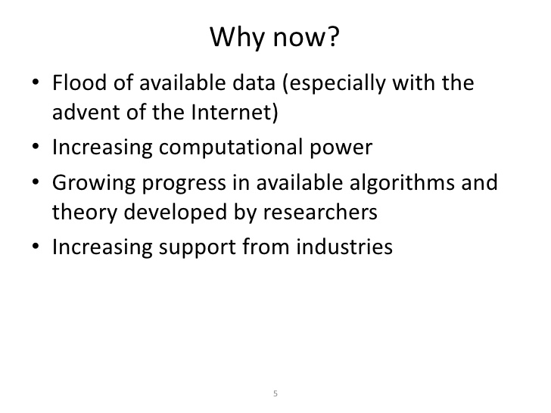

Slide 5
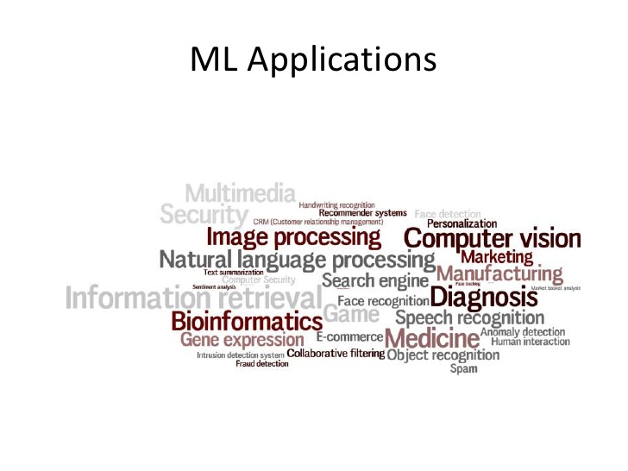
These are the real life fields in which Machine Learning is being constantly applied in our day to day life.

Slide 6
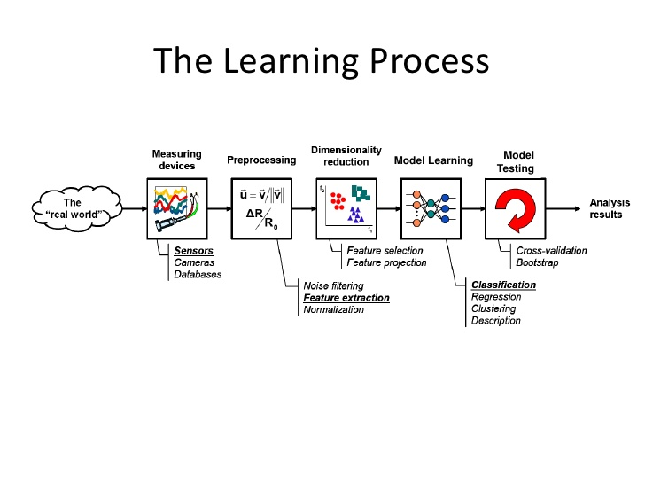

Slide 7
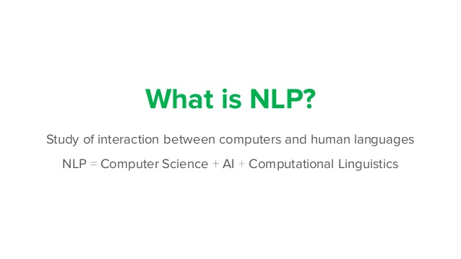
NATURAL LANGUAGE PROCESSING is a combination of a series of techniques, to create a human and computer interaction medium verbally using High Level Languages(HLL).

Slide 8
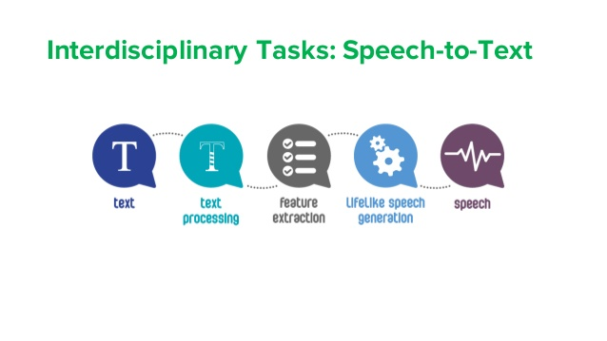

Slide 9
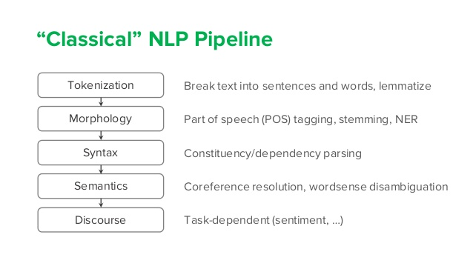

Slide 10
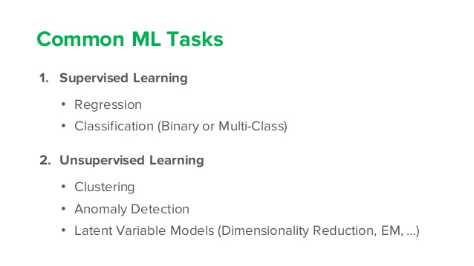

Slide 11
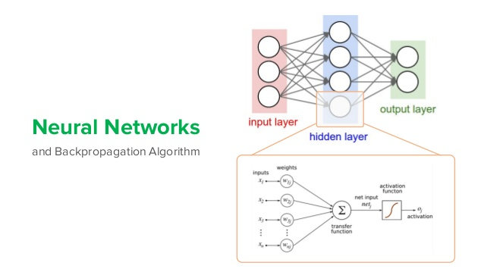

Slide 12
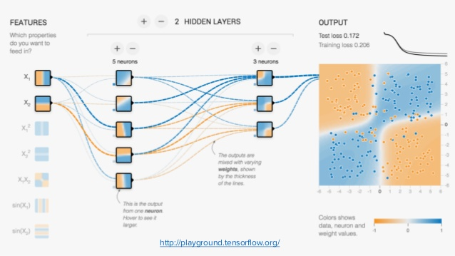

Slide 13
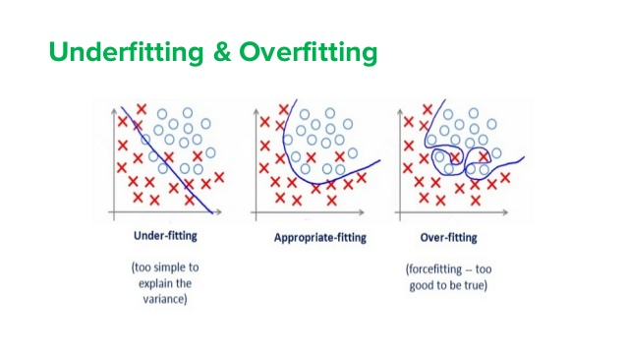

Slide 14
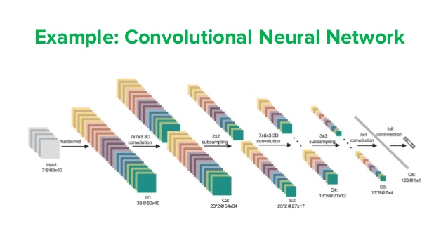

Slide 15
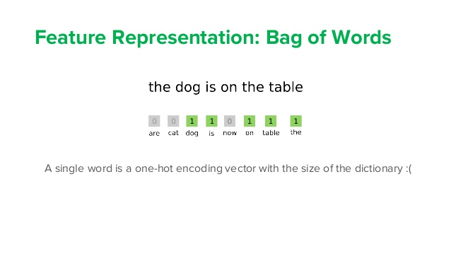

Slide 16
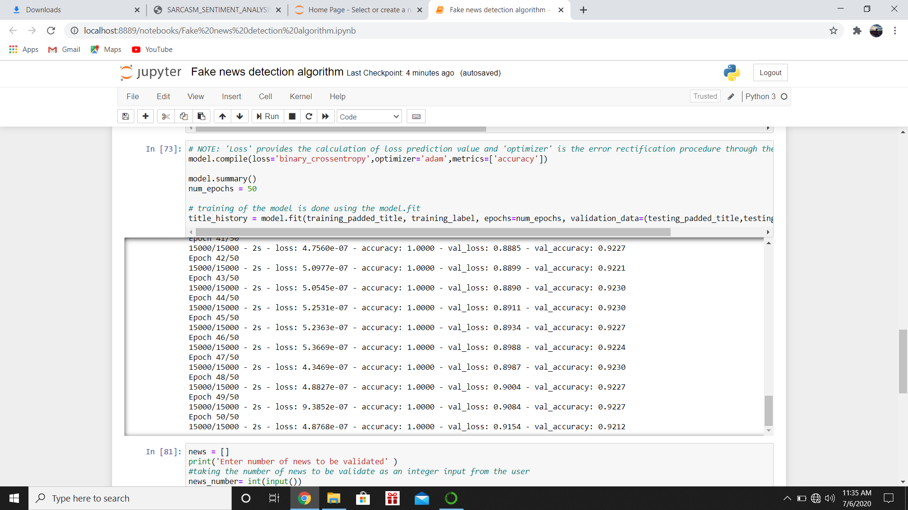

Slide 17
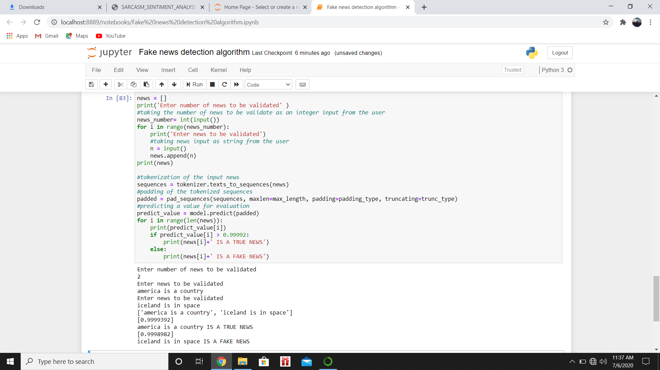

Slide 18
THE END
THANK YOU

